Slide 1
CS405/505 Data Mining
Lecture 19

Slide 2
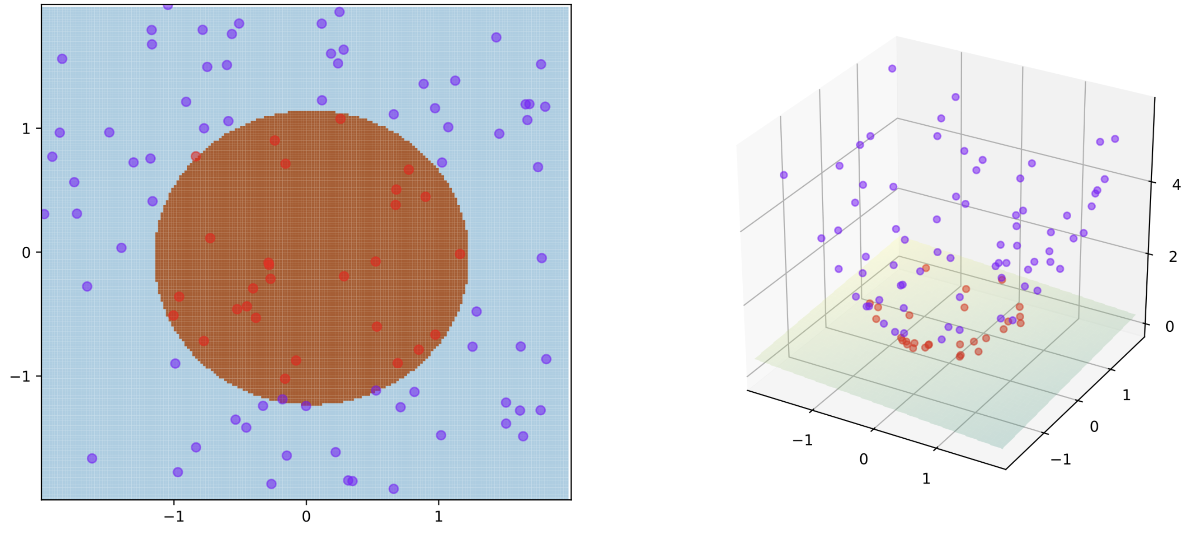
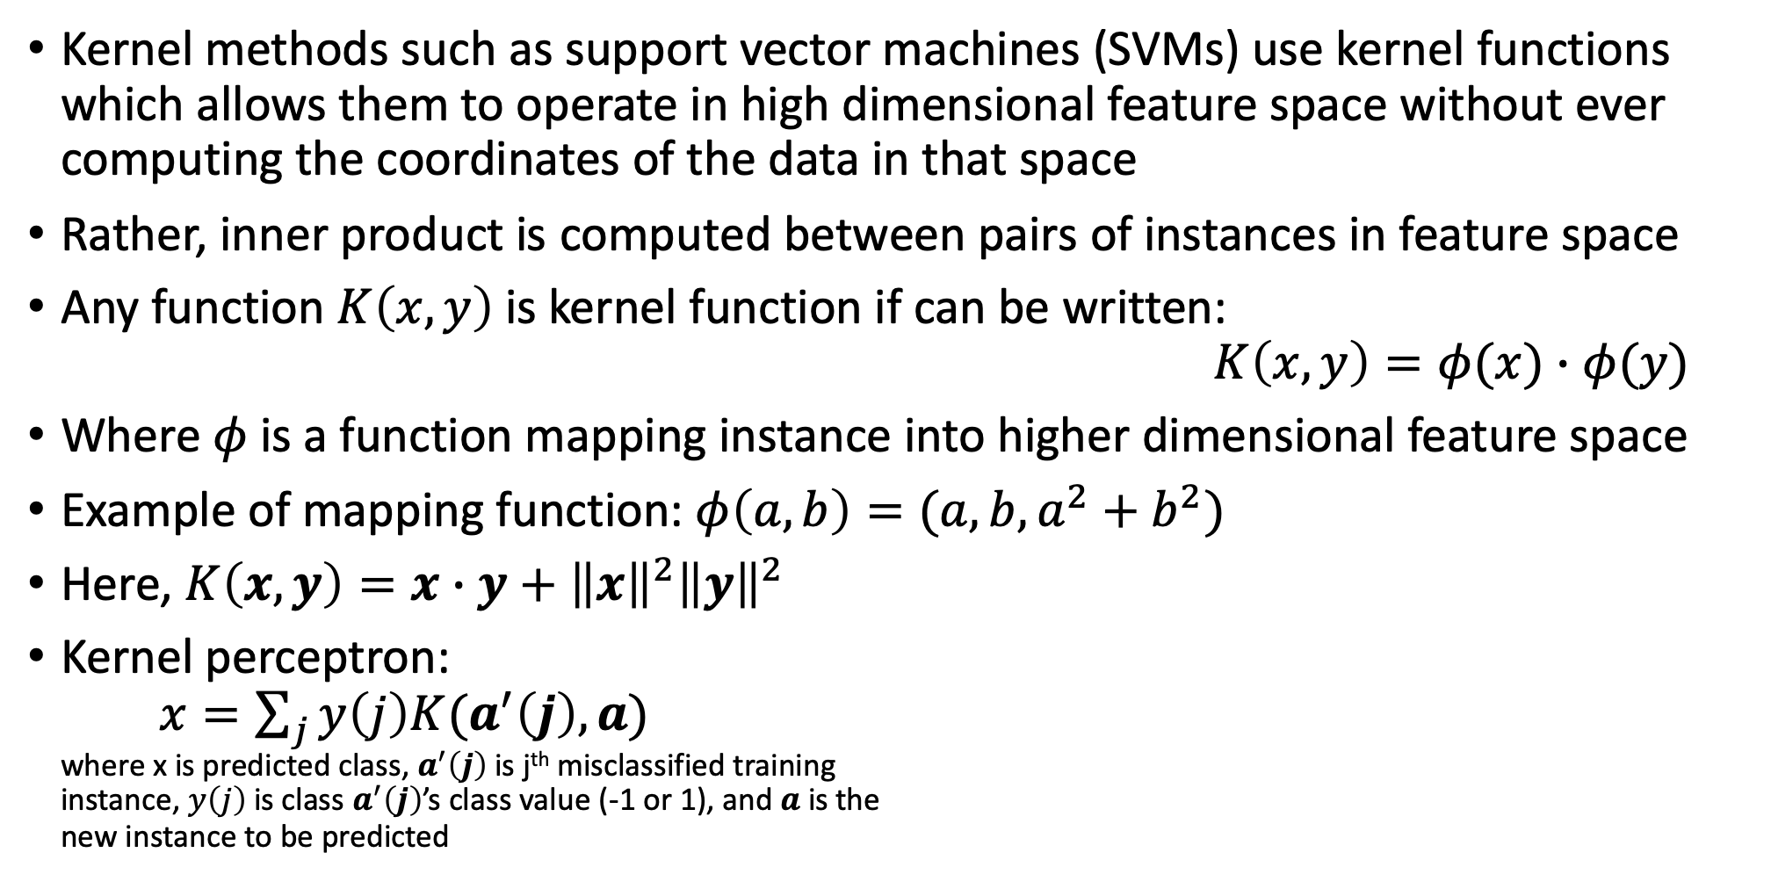
Kernel recap
Kernel methods such as support vector machines (SVMs) use kernel functions which allows them to operate in high dimensional feature space without ever computing the coordinates of the data in that space
Rather, inner product is computed between pairs of instances in feature space
Any function $K\left(x,y\right)$ is kernel function if can be written: $K\left(x,y\right)=φ(x)∙φ(y)$
Where $φ$ is a function mapping instance into higher dimensional feature space
Example of mapping function: $φ\left(a,b\right)=(a,b,a^{2}+b^{2})$
Here, $K\left(x,y\right)=x∙y+{\left\|x\right\|}^{2}{\left\|y\right\|}^{2}$
Kernel perceptron: $x=\sum_{j}{y\left(j\right)K(a^{′}\left(j\right),a)}$ where x is predicted class, $a^{′}\left(j\right)$ is j^{th} misclassified training instance, $y\left(j\right)$ is class $a^{′}\left(j\right)$’s class value (-1 or 1), and $a$ is the new instance to be predicted

Slide 3
Multilayer Perceptrons
Using a kernel is not the only way to create nonlinear classifier with perceptron
Before discovery of kernels (1990s), nonlinear classification was done by connecting many simple perceptron-like models in a hierarchical structure
Recently, this approach has seen dramatic comeback (deep learning, chapter 11)
Brain analogy: single-layer perceptron can be seen as one neuron
The brain performs impressive feats by connecting multiple neurons together
We will now see how multilayer perceptrons perform nonlinear classification

Slide 4
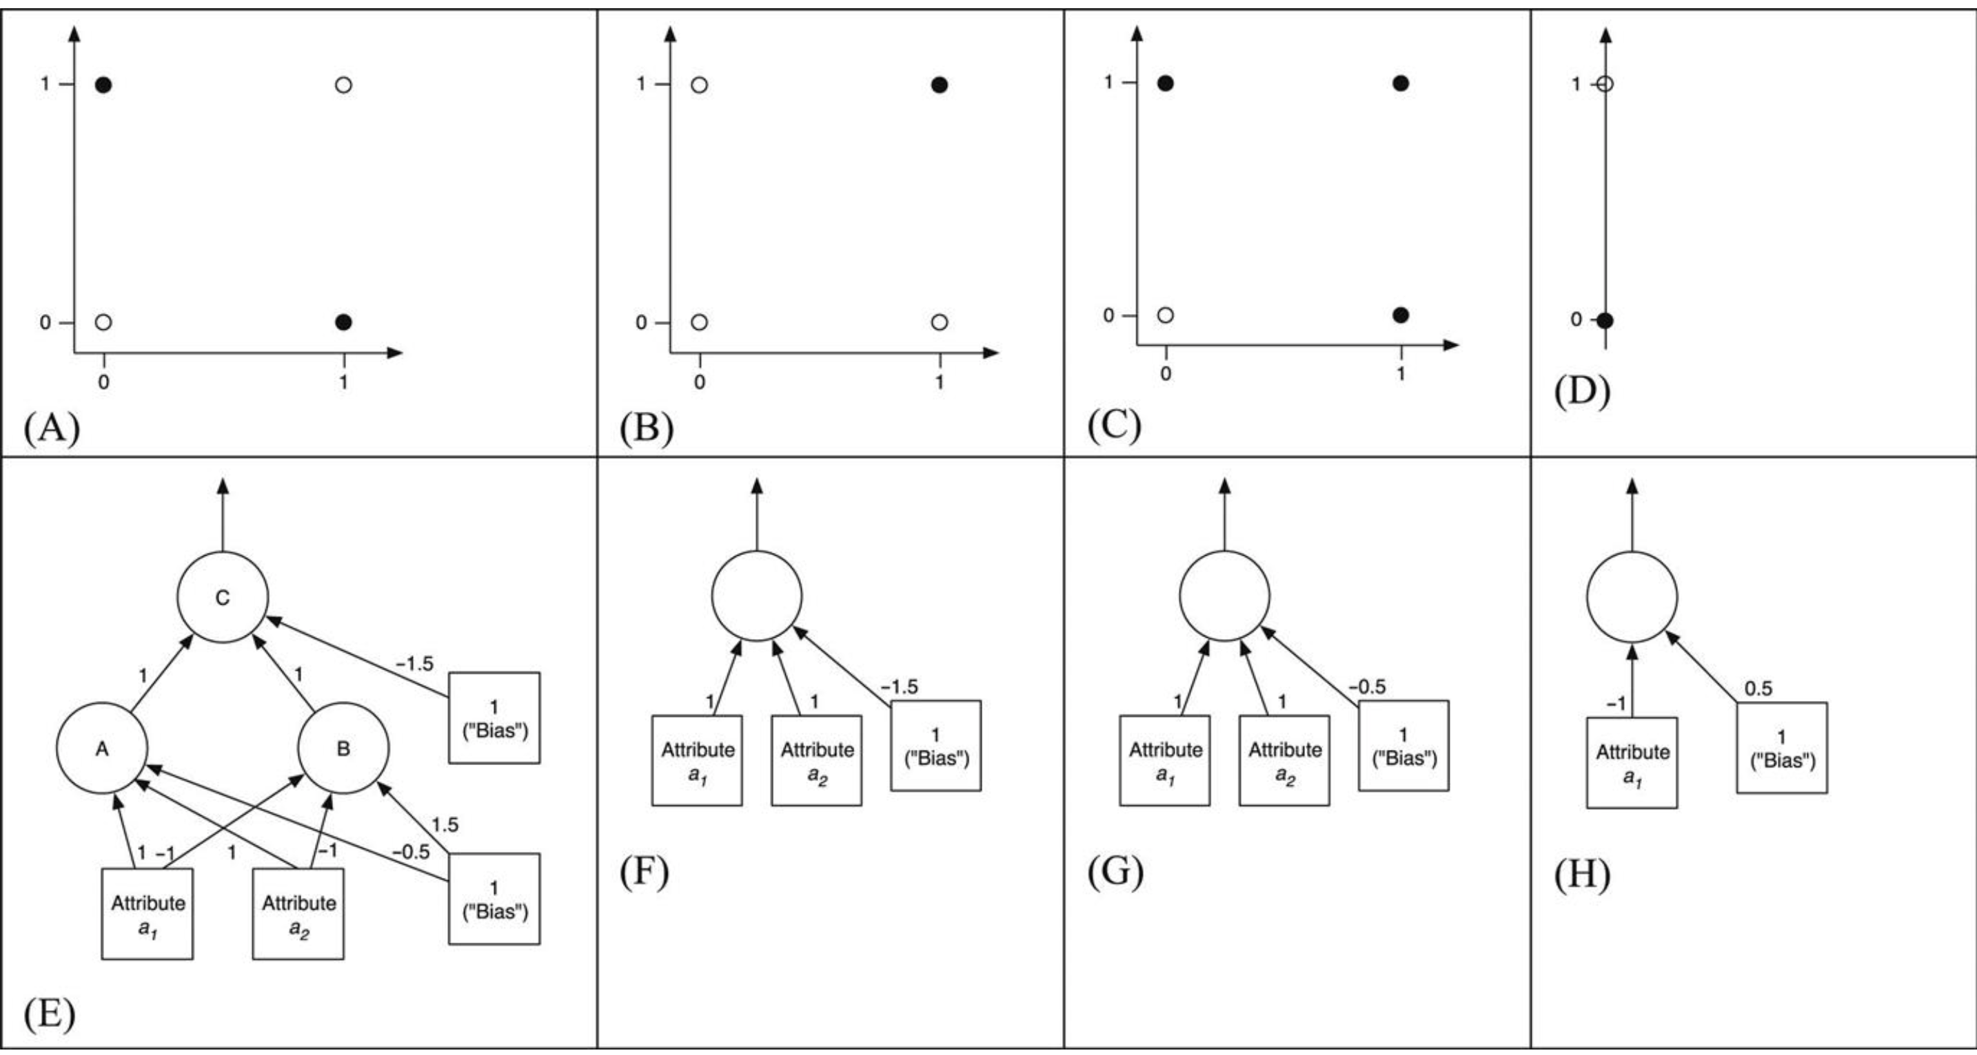
The classes in (A) are not linearly separable but (B, C, D) are all linearly separable
(B, C, D) can all be learned by single-layer perceptron
E) shows a network with 3 perceptrons (units) labeled A,B,C

Slide 5
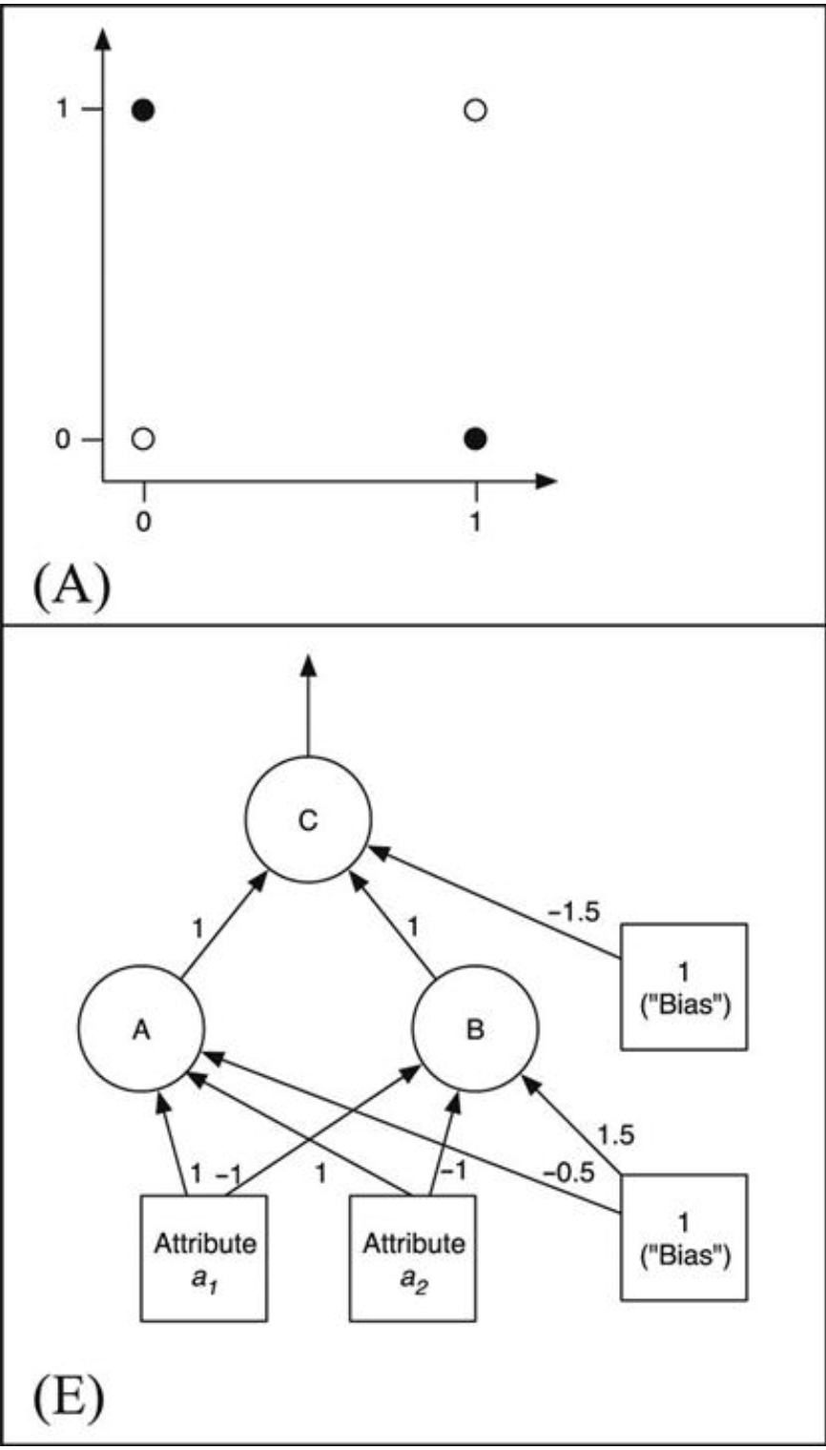
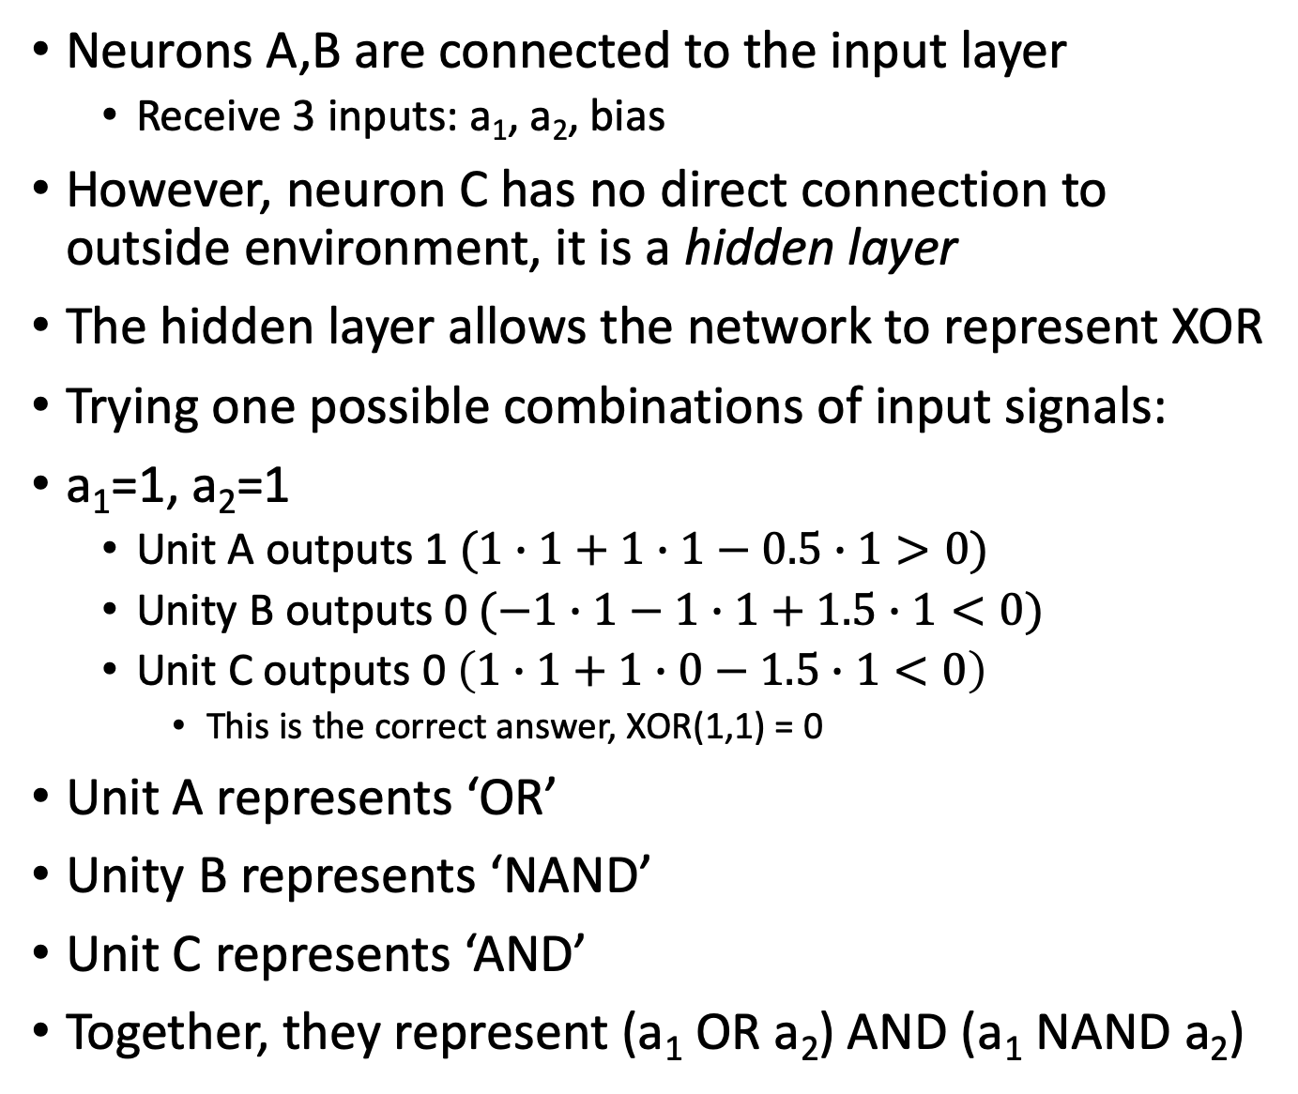
Neurons A,B are connected to the input layer
Receive 3 inputs: a₁, a₂, bias
However, neuron C has no direct connection to outside environment, it is a hidden layer
The hidden layer allows the network to represent XOR
Trying one possible combinations of input signals:
a₁=1, a₂=1
Unit A outputs 1 $(1∙1+1∙1−0.5∙1>0)$
Unity B outputs 0 $(−1∙1−1∙1+1.5∙1<0)$
Unit C outputs 0 $\left(1∙1+1∙0−1.5∙1<0\right)$
This is the correct answer, XOR(1,1) = 0
Unit A represents ‘OR’
Unity B represents ‘NAND’
Unit C represents ‘AND’
Together, they represent (a₁ OR a₂) AND (a₁ NAND a₂)

Slide 6
Multilayer perceptrons (MLPs)
Any expression from propositional logic can be converted into a multilayer perceptron, because AND, OR, and NOT can be represented by single perceptron
Individual units can be combined together to form arbitrarily complex expression
Two layer perceptron (not counting input) is sufficient to represent expressions from propositional logic
Big question is how to learn a multilayer perceptron?
Need to learn two things:
1) structure of network (hyper-parameter)
2) values of the weights
Backpropagation is a simple algorithm for determining the values of the weights
Learning the structure of network is more complicated
Requires expert knowledge or lots of hyperparameter tuning
Often, only a single hidden layer is necessary

Slide 7
Backpropagation
Suppose we seek to construct a multilayer perceptron for some dataset
Given a fixed network structure, must determine appropriate connection weights
In the absence of hidden layers, can find weights using perceptron learning rule
We could use the perceptron learning rule to update the final layer because we know what their output should be
However, the correct outputs of the hidden layer are unknown, so we cannot use the perceptron learning rule for hidden units
The solution is to modify weights of connections leading to hidden units based on the strength of each unit’s contribution to the final prediction
Standard mathematical optimization technique gradient descent can do this
Gradient descent involves taking derivatives, but the perceptron’s output (step function) is not differentiable

Slide 8
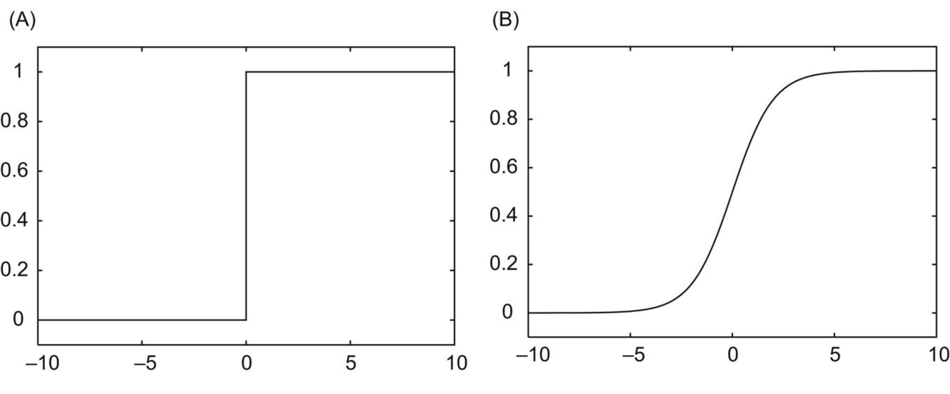
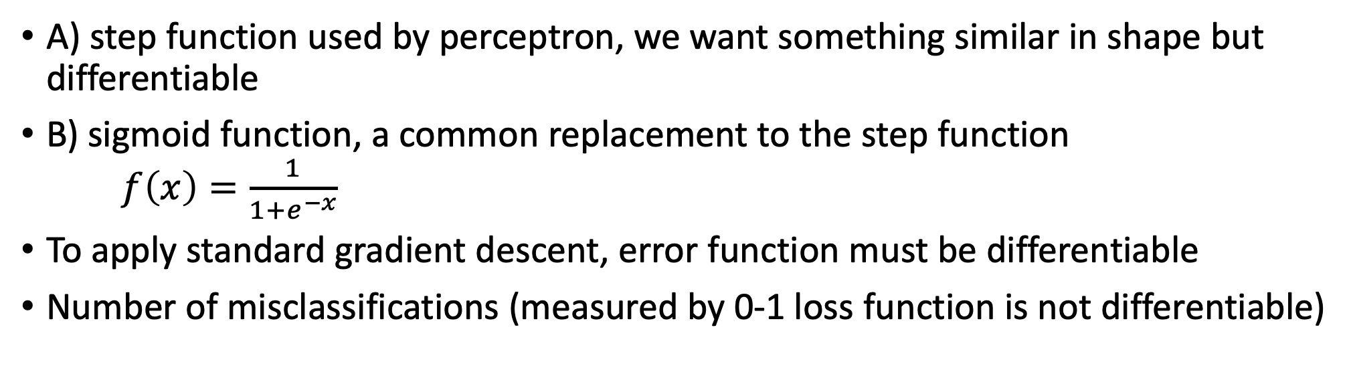
Backpropagation
A) step function used by perceptron, we want something similar in shape but differentiable
B) sigmoid function, a common replacement to the step function $f\left(x\right)=\frac{1}{1+e^{−x}}$
To apply standard gradient descent, error function must be differentiable
Number of misclassifications (measured by 0-1 loss function is not differentiable)

Slide 9
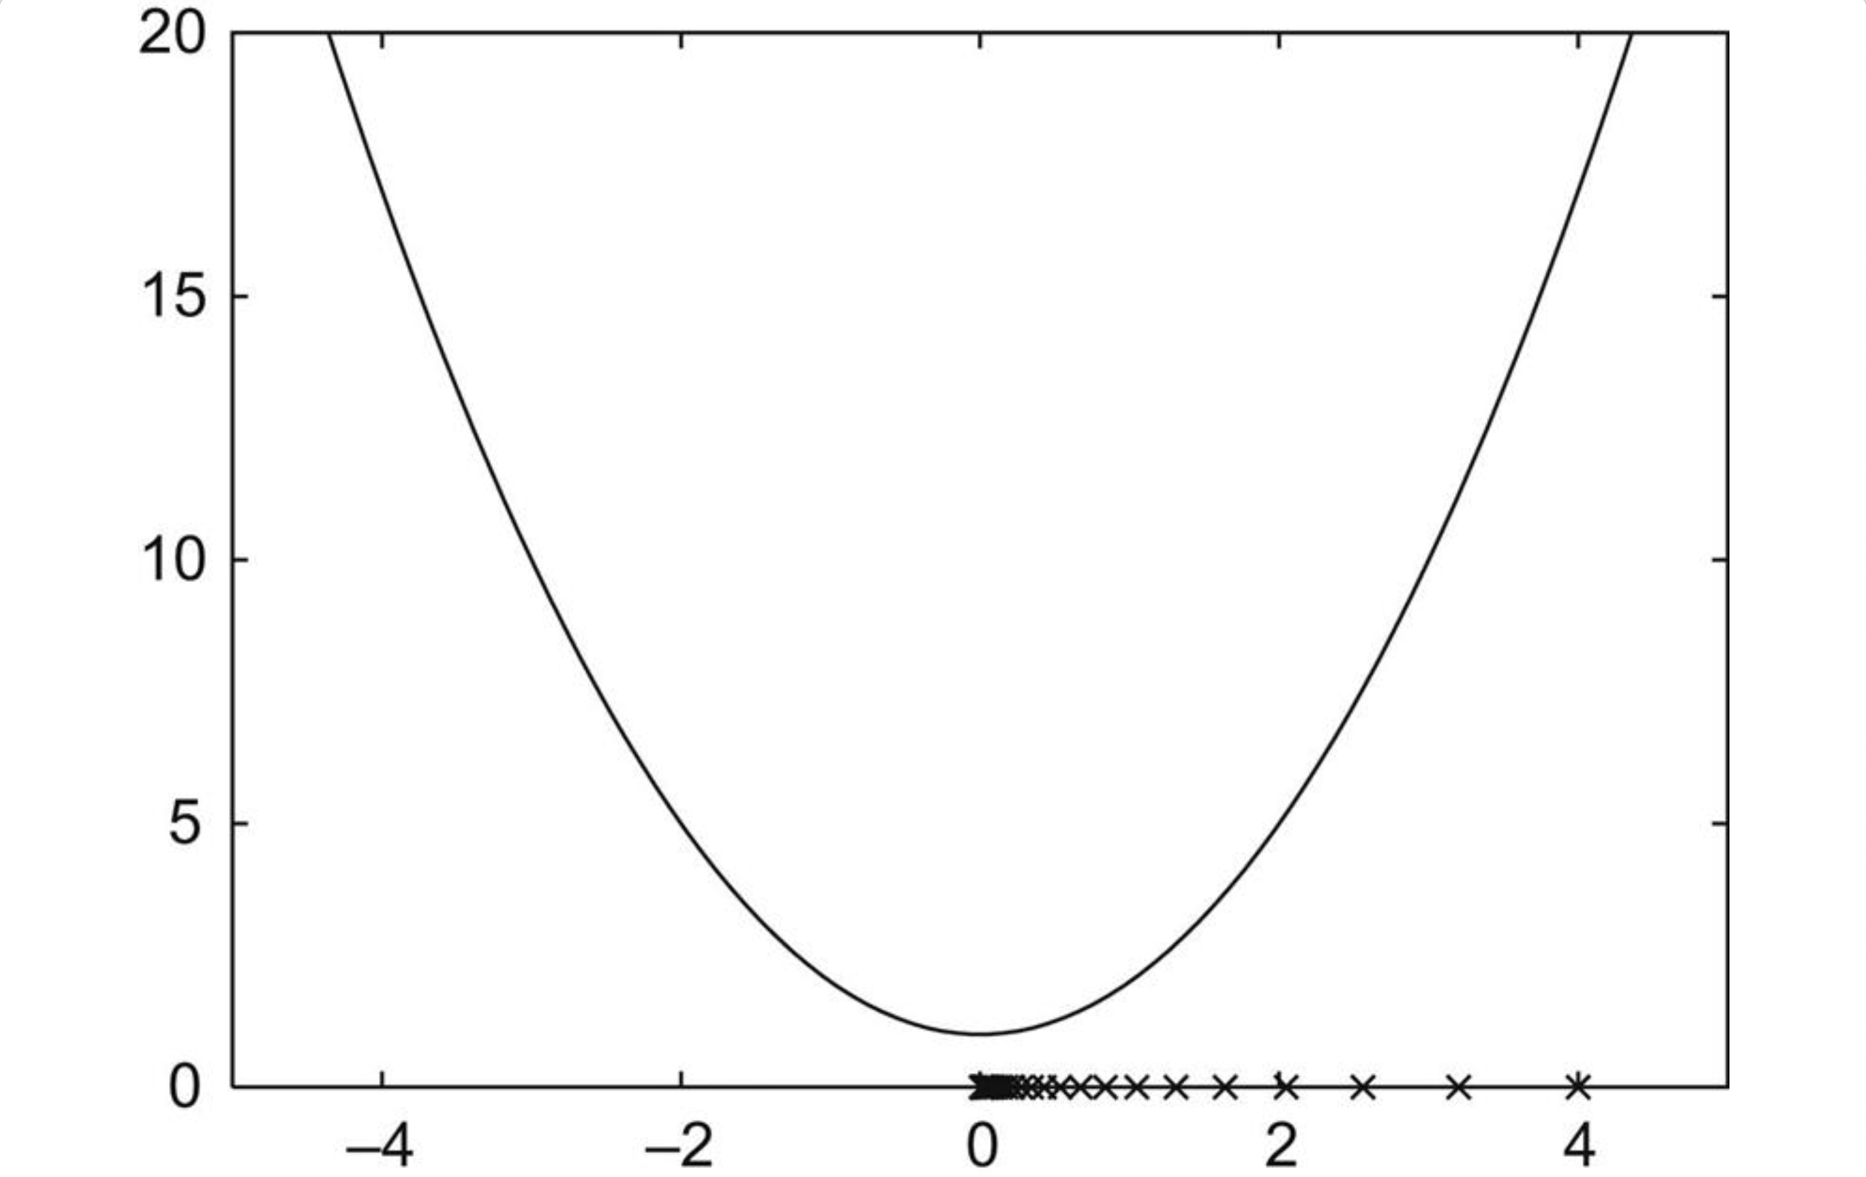
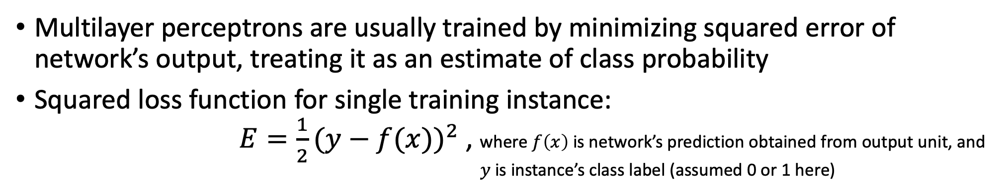
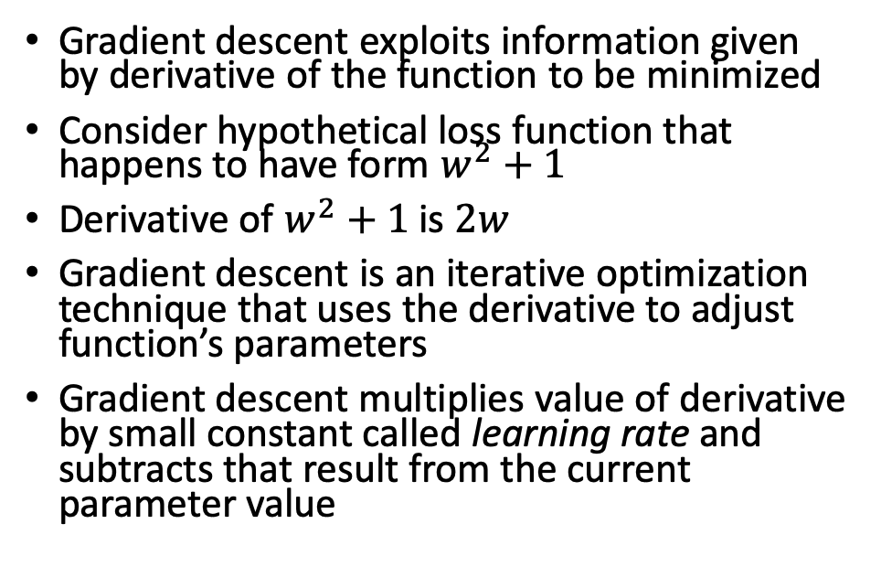
Backpropagation – loss function & gradient descent
Multilayer perceptrons are usually trained by minimizing squared error of network’s output, treating it as an estimate of class probability
Squared loss function for single training instance: $E=\frac{1}{2}{(y−f(x))}^{2}$ , where $f\left(x\right)$ is network’s prediction obtained from output unit, and $y$ is instance’s class label (assumed 0 or 1 here)
Gradient descent exploits information given by derivative of the function to be minimized
Consider hypothetical loss function that happens to have form $w^{2}+1$
Derivative of $w^{2}+1$is $2w$
Gradient descent is an iterative optimization technique that uses the derivative to adjust function’s parameters
Gradient descent multiplies value of derivative by small constant called learning rate and subtracts that result from the current parameter value

Slide 10
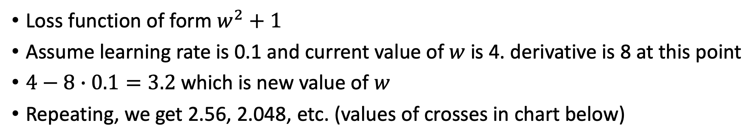
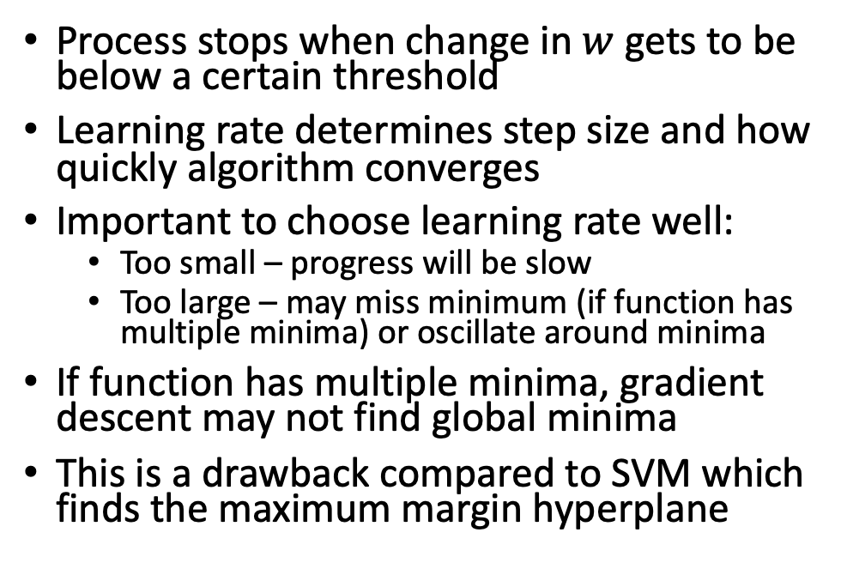
Backpropagation – loss function & gradient descent
Loss function of form $w^{2}+1$
Assume learning rate is 0.1 and current value of $w$ is 4. derivative is 8 at this point
$4−8∙0.1=3.2$ which is new value of $w$
Repeating, we get 2.56, 2.048, etc. (values of crosses in chart below)
Process stops when change in $w$ gets to be below a certain threshold
Learning rate determines step size and how quickly algorithm converges
Important to choose learning rate well:
Too small – progress will be slow
Too large – may miss minimum (if function has multiple minima) or oscillate around minima
If function has multiple minima, gradient descent may not find global minima
This is a drawback compared to SVM which finds the maximum margin hyperplane

Slide 11
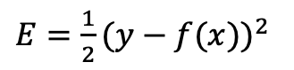
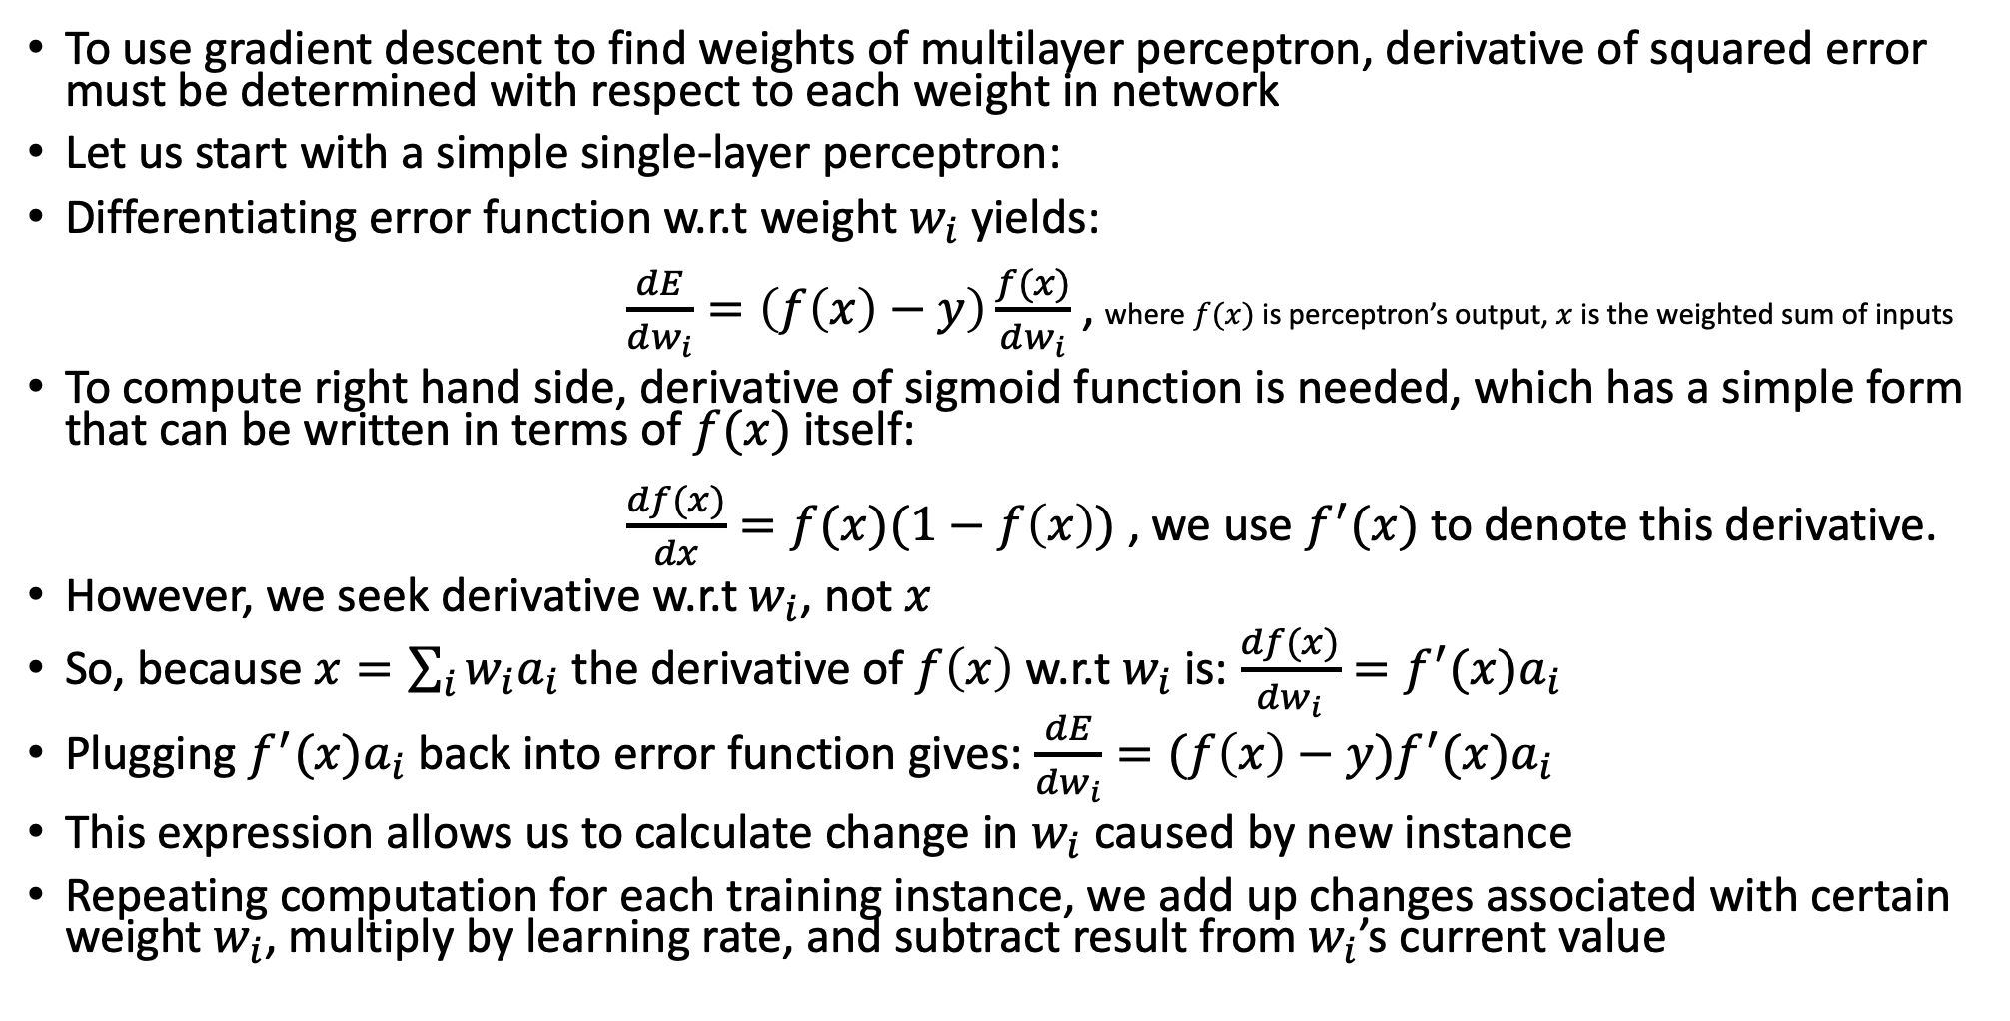
Using gradient descent to find weights
To use gradient descent to find weights of multilayer perceptron, derivative of squared error must be determined with respect to each weight in network
Let us start with a simple single-layer perceptron:
Differentiating error function w.r.t weight $w_{i}$ yields: $\frac{dE}{dw_{i}}=\left(f\left(x\right)−y\right)\frac{f(x)}{dw_{i}}$ , where $f(x)$ is perceptron’s output, $x$ is the weighted sum of inputs
To compute right hand side, derivative of sigmoid function is needed, which has a simple form that can be written in terms of $f(x)$ itself: $\frac{df(x)}{dx}=f(x)(1−f\left(x\right))$ , we use $f^{′}(x)$ to denote this derivative.
However, we seek derivative w.r.t $w_{i}$, not $x$
So, because $x=\sum_{i}{w_{i}a_{i}}$ the derivative of $f\left(x\right)$ w.r.t $w_{i}$ is: $\frac{df(x)}{dw_{i}}=f^{′}(x)a_{i}$
Plugging $f^{′}(x)a_{i}$ back into error function gives: $\frac{dE}{dw_{i}}=(f\left(x\right)−y)f^{′}(x)a_{i}$
This expression allows us to calculate change in $w_{i}$ caused by new instance
Repeating computation for each training instance, we add up changes associated with certain weight $w_{i}$, multiply by learning rate, and subtract result from $w_{i}$’s current value
$E=\frac{1}{2}{(y−f(x))}^{2}$

Slide 12
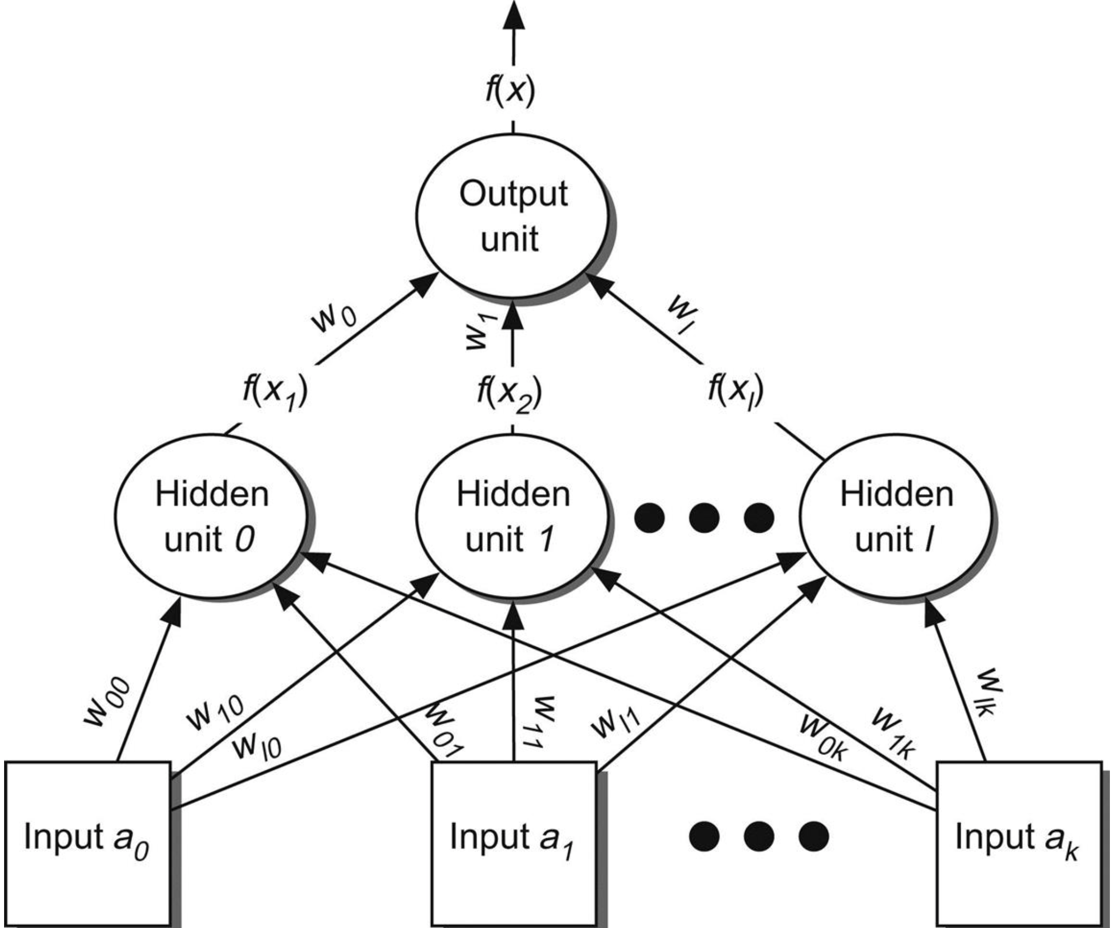
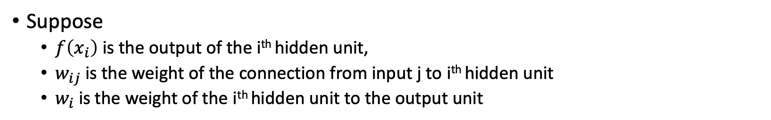
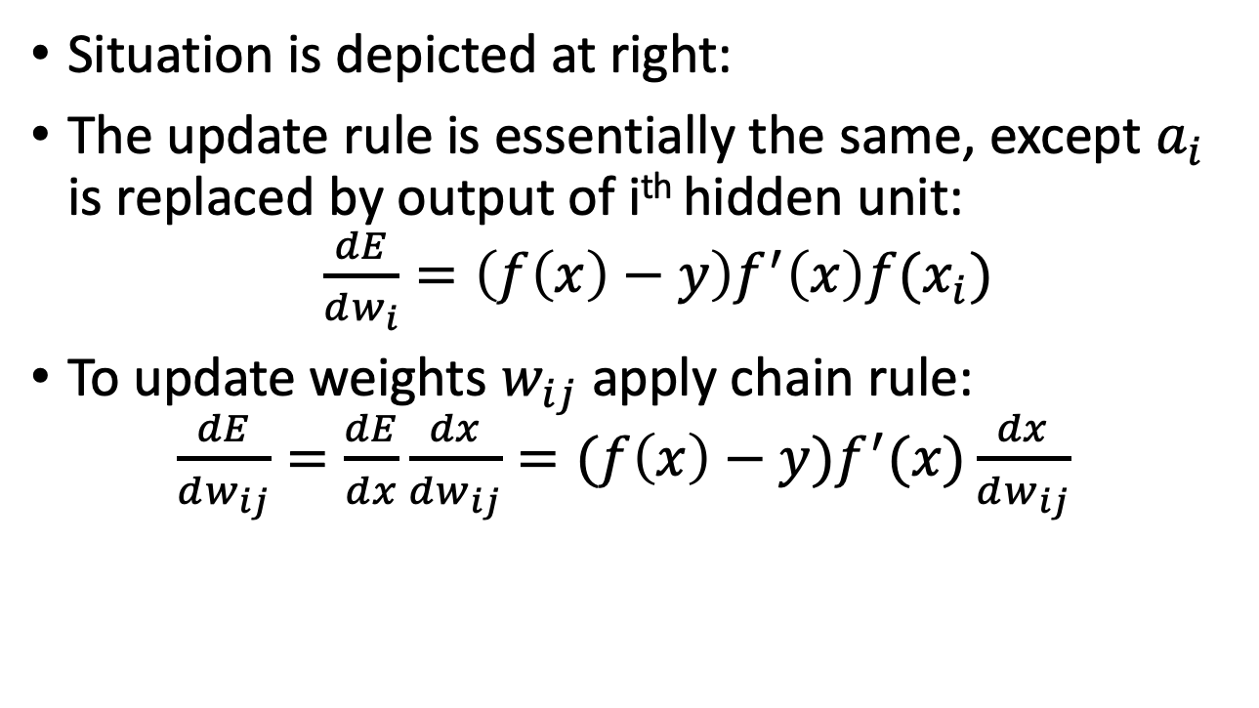
Gradient descent to find weights in hidden layer
Suppose
$f\left(x_{i}\right)$ is the output of the i^{th} hidden unit,
$w_{ij}$ is the weight of the connection from input j to i^{th} hidden unit
$w_{i}$ is the weight of the i^{th} hidden unit to the output unit
Situation is depicted at right:
The update rule is essentially the same, except $a_{i}$ is replaced by output of i^{th} hidden unit: $\frac{dE}{dw_{i}}=\left(f\left(x\right)−y\right)f^{′}\left(x\right)f(x_{i})$
To update weights $w_{ij}$ apply chain rule: $\frac{dE}{dw_{ij}}=\frac{dE}{dx}\frac{dx}{dw_{ij}}=(f\left(x\right)−y)f^{′}(x)\frac{dx}{dw_{ij}}$

Slide 13
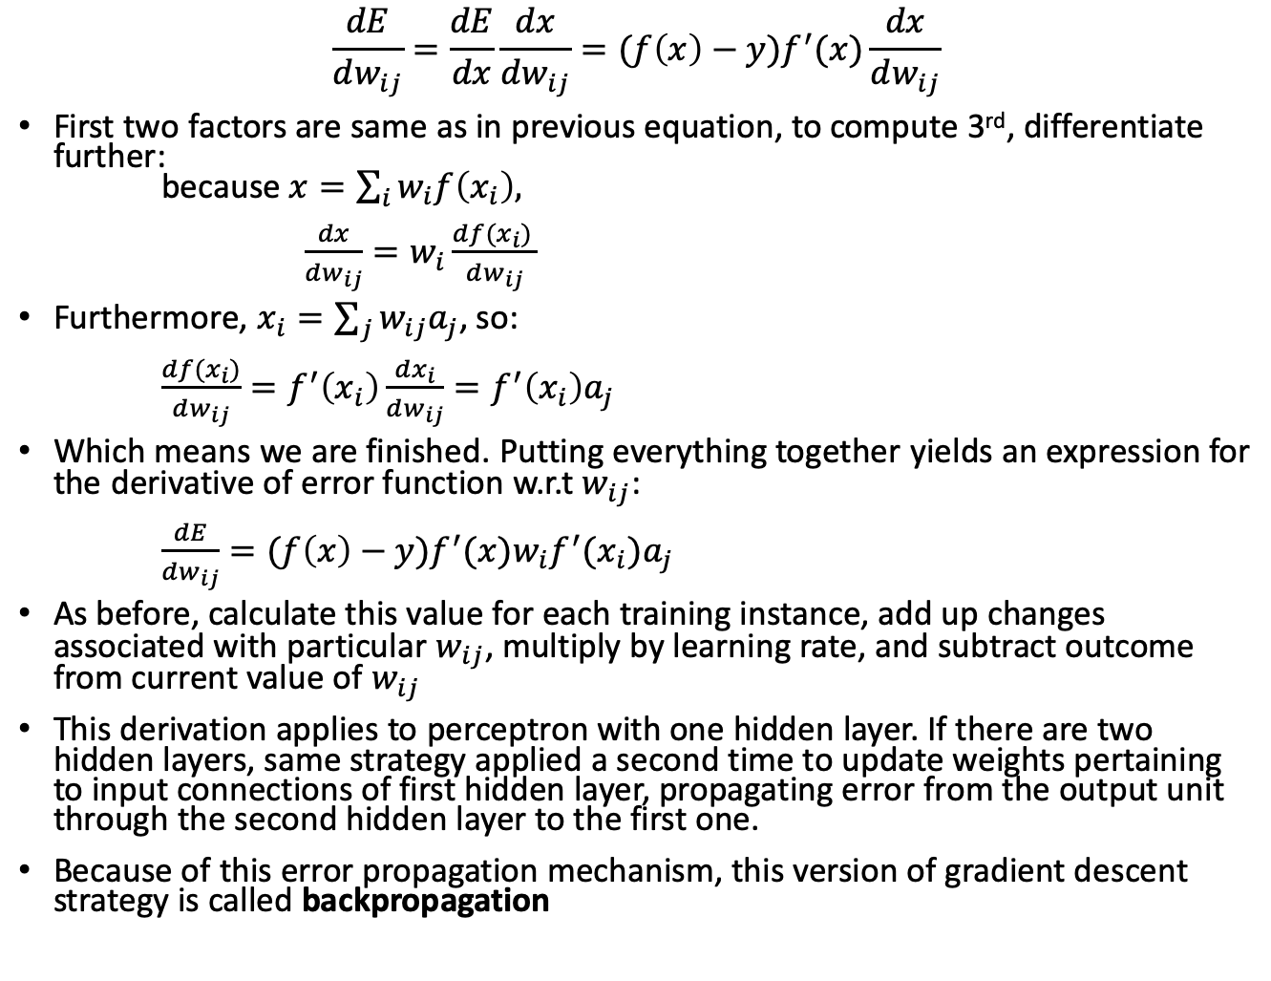
Gradient descent to find weights in hidden layer
$$\frac{dE}{dw_{ij}}=\frac{dE}{dx}\frac{dx}{dw_{ij}}=(f\left(x\right)−y)f^{′}(x)\frac{dx}{dw_{ij}}$$
First two factors are same as in previous equation, to compute 3rd, differentiate further: because $x=\sum_{i}{w_{i}f\left(x_{i}\right),}$ $\frac{dx}{dw_{ij}}=w_{i}\frac{df(x_{i}) }{dw_{ij}}$
Furthermore, $x_{i}=\sum_{j}{w_{ij}a_{j}}$, so: $\frac{df(x_{i})}{dw_{ij}}=f^{′}\left(x_{i}\right)\frac{dx_{i}}{dw_{ij}}=f^{′}\left(x_{i}\right)a_{j}$
Which means we are finished. Putting everything together yields an expression for the derivative of error function w.r.t $w_{ij}$: $\frac{dE}{dw_{ij}}=(f\left(x\right)−y)f^{′}(x)w_{i}f^{′}(x_{i})a_{j}$
As before, calculate this value for each training instance, add up changes associated with particular $w_{ij}$, multiply by learning rate, and subtract outcome from current value of $w_{ij}$
This derivation applies to perceptron with one hidden layer. If there are two hidden layers, same strategy applied a second time to update weights pertaining to input connections of first hidden layer, propagating error from the output unit through the second hidden layer to the first one.
Because of this error propagation mechanism, this version of gradient descent strategy is called backpropagation

Slide 14
Further remarks on backprop/gradient descent/MLP
We assumed network’s output is a single unit, appropriate for two-class problem
For more than two classes, create an output unit for each class, connecting every unit in hidden layer to every output unit
Here, squared error for particular training instance is sum of errors over all output units
We assumed weights are only updated after all training instances fed to network
This is called batch learning, because all training data is processed together
Weights can also be updated after each individual instance
Called stochastic backpropagation, because overall error does not necessarily decrease after each update
Often useful to standardize attributes before training network
Weights are typically initialized to small, random value based on 0-mean gaussian
Multilayer perceptrons trained with backprop can suffer from overfitting, multiple techniques have been developed to help with this:
Early stopping – use holdout set to decide when to stop iterating with backpropagation
Weight decay – penalizes large weights that do not contribute to large reduction in error
Multilayer perceptrons belong to class of neural network called feedforward networks because connections do not contain cycles and output depends only on current instance

Slide 15
Radial basis function (RBF) networks
Another popular type of feedforward network is the RBF network
RBF has two layers (not counting input) and differs from MLP in way hidden units perform computations
Each hidden unit represents a particular point in input space
Output (activation) for a given instance depends on distance between the hidden unit and the instance
The closer the two points, the stronger the activation
Nonlinear transformation function converts distance into similarity measure
Gaussian activation function (different width for each hidden unit) is commonly used for this purpose
Hidden units are called RBFs because points in instance space for which a hidden unit produces same activation form a hypersphere or hyperellipsoid
In multilayer perceptron, this is a hyperplane

Slide 16
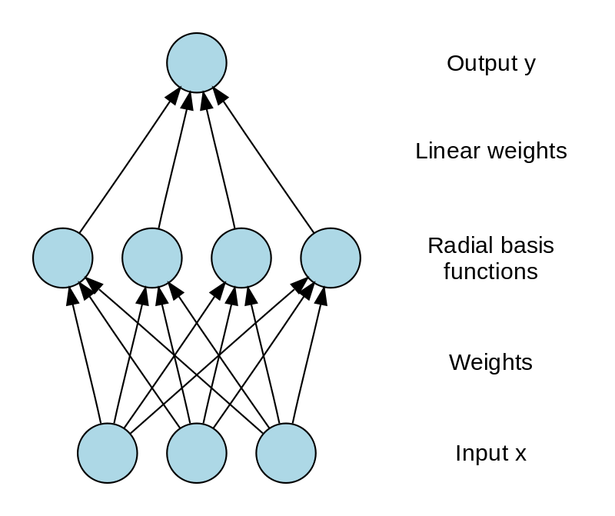
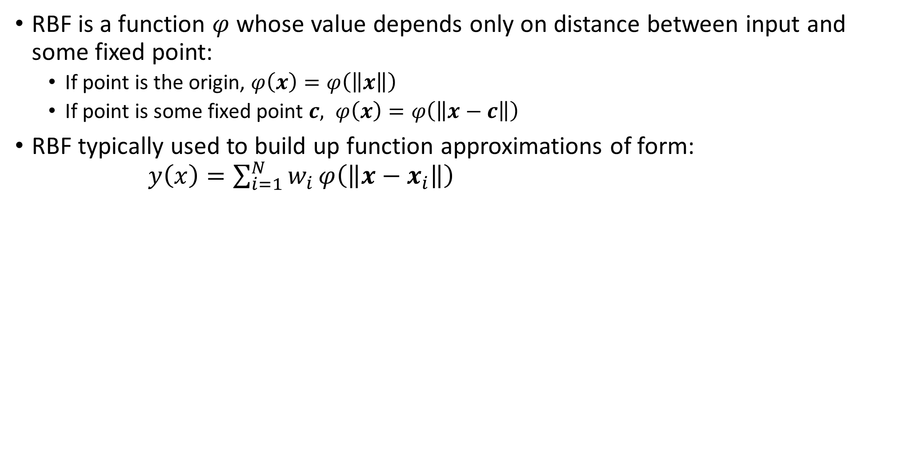
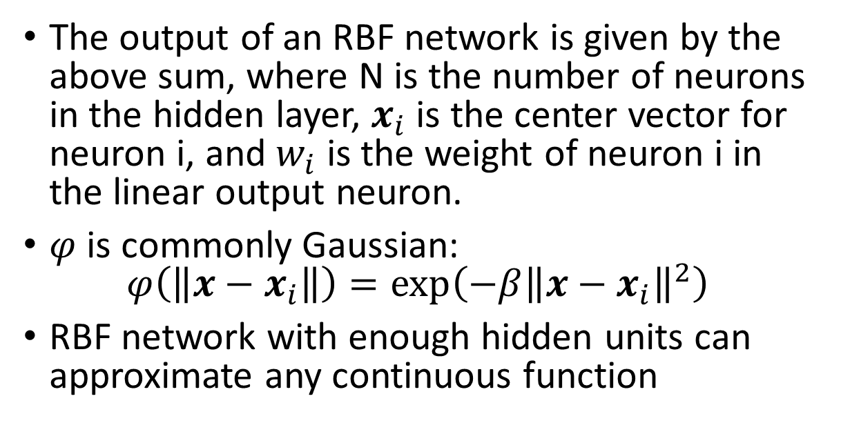
Radial basis function (RBF)
RBF is a function $φ$ whose value depends only on distance between input and some fixed point:
If point is the origin, $φ\left(x\right)=φ\left(\left\|x\right\|\right)$
If point is some fixed point $c, φ\left(x\right)=φ\left(\left\|x−c\right\|\right)$
RBF typically used to build up function approximations of form: $y\left(x\right)=\sum_{i=1}^{N}{w_{i}}φ\left(\left\|x−x_{i}\right\|\right)$
The output of an RBF network is given by the above sum, where N is the number of neurons in the hidden layer, $x_{i}$ is the center vector for neuron i, and $w_{i}$ is the weight of neuron i in the linear output neuron.
$φ$ is commonly Gaussian: $φ\left(\left\|x−x_{i}\right\|\right)=\exp\left(−β{\left\|x−x_{i}\right\|}^{2}\right)$
RBF network with enough hidden units can approximate any continuous function

Slide 17
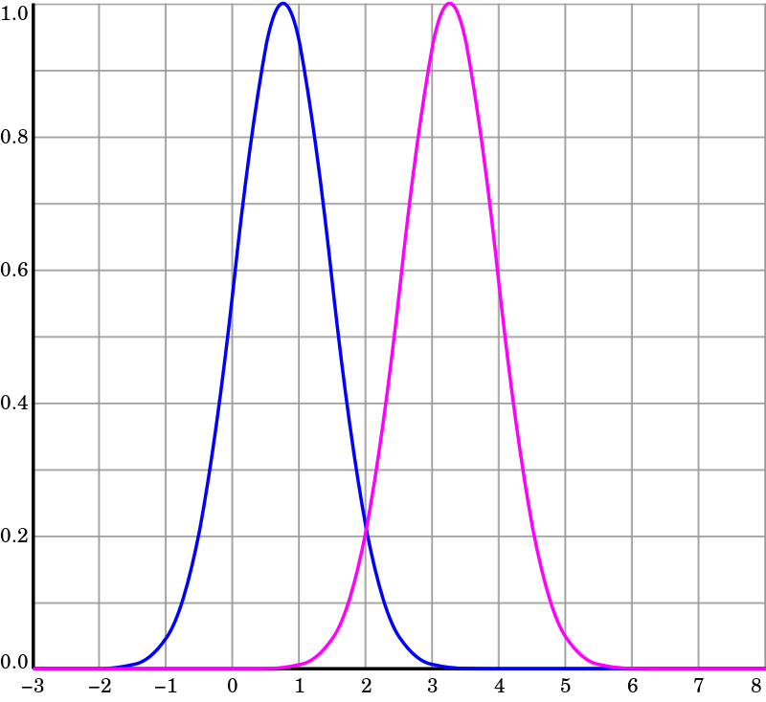
RBF networks
RBFs learn:
1) the centers and widths of radial basis functions
2) the weights used to form the linear combination of outputs obtained from the hidden layer
Advantage of RBF over MLP:
Parameters from (1) above can be learned independently from (2) and still produce fairly accurate classifiers
Center/width of radial basis functions can be learned using clustering
Example: use k-means clustering on each class independently, to obtain k basis functions for each class
Resulting RBFs represent prototype instances
Second set of parameters can then be learned by keeping the first fixed
Two radial basis functions in one input dimension, centers at c1=0.75 and c2=3.25
https://en.wikipedia.org/wiki/Radial_basis_function_network

Slide 18
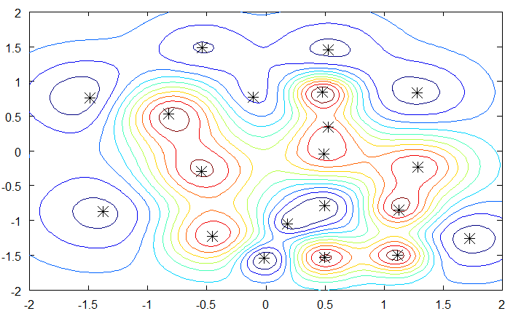
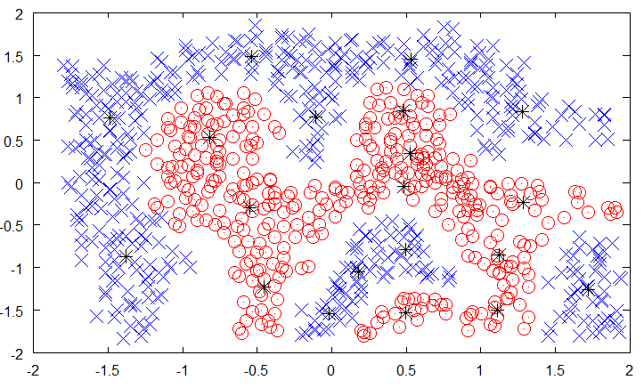
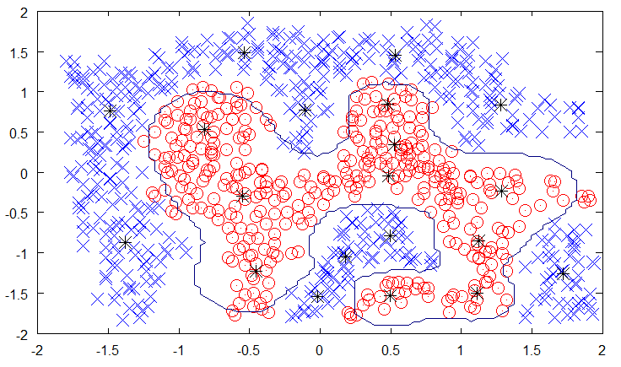
RBF network dataset example
RBF network class 1, RBF network class 2
Prototype instances shown by * asterisk
https://mccormickml.com/2013/08/15/radial-basis-function-network-rbfn-tutorial/
RBF network decision boundary

Slide 19
Summary
Multilayer perceptrons (MLPs) can learn nonlinear functions
Backpropagation can be used to efficiently train MLPs
Standard feed-forward neural networks typically only require a single hidden layer to achieve optimal performance (not so for convnets)
RBF networks are another type of feedforward neural network
RBF more robust in presence of noise
However, RBFs do not perform dimensionality reduction
Convolutional neural networks can perform dimensionality reduction
Next: deep learning and convnets

